Slide 1
SUPER-B
Koos Biesmeijer

Slide 2
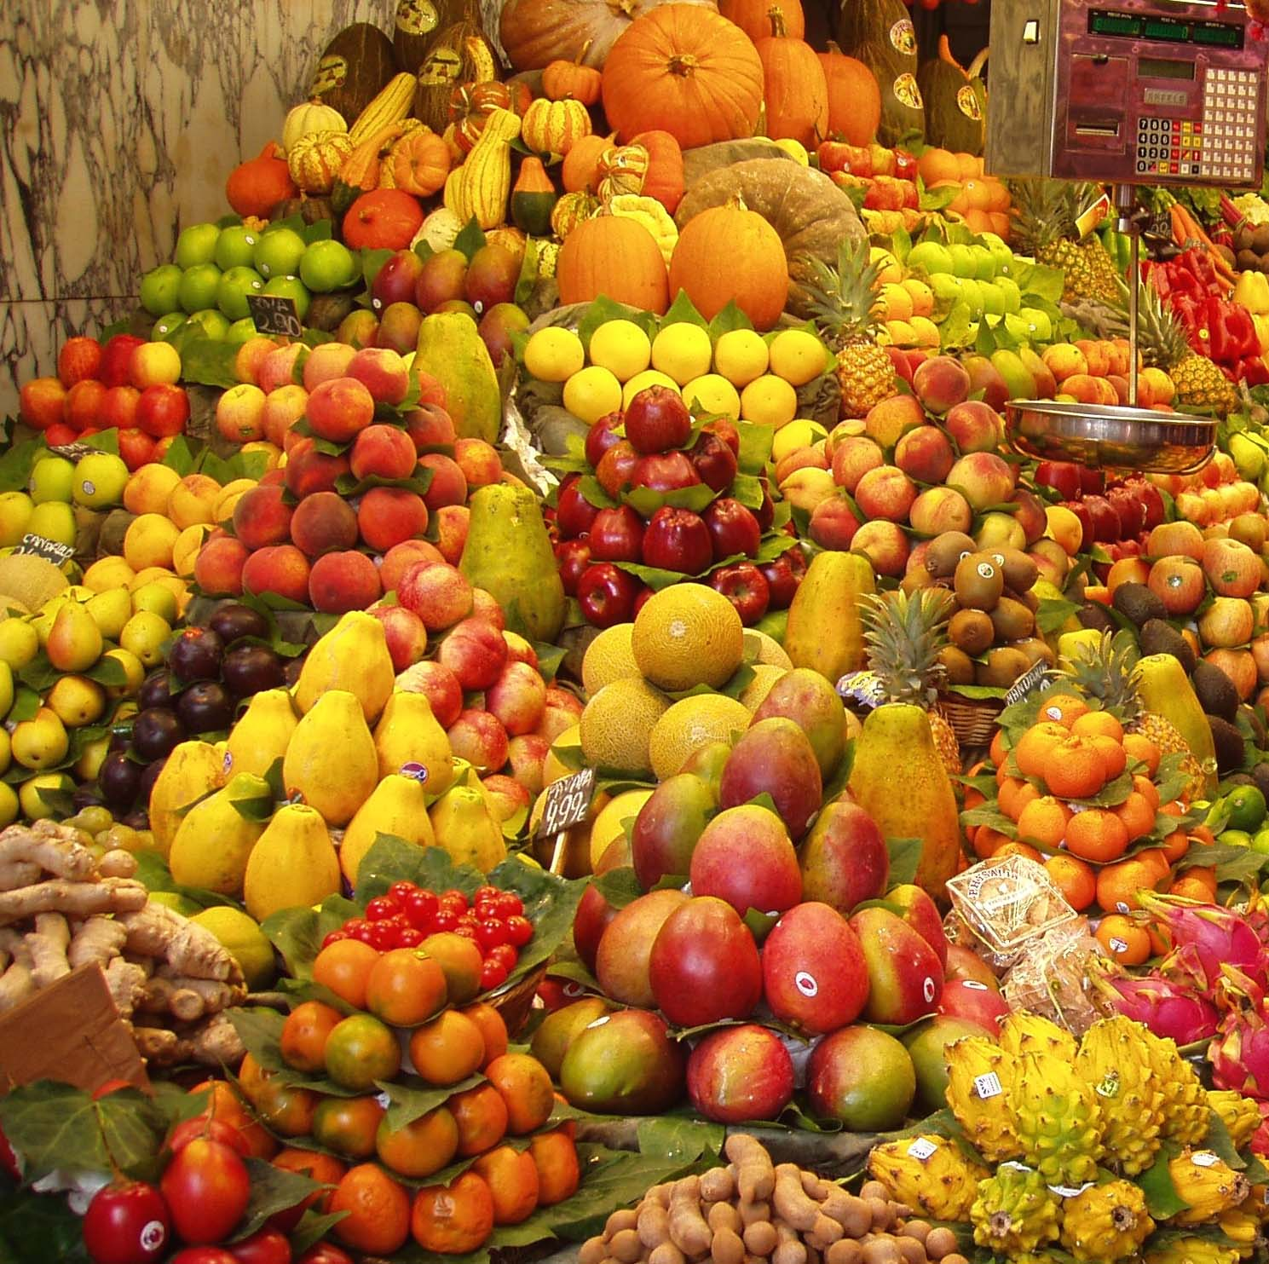
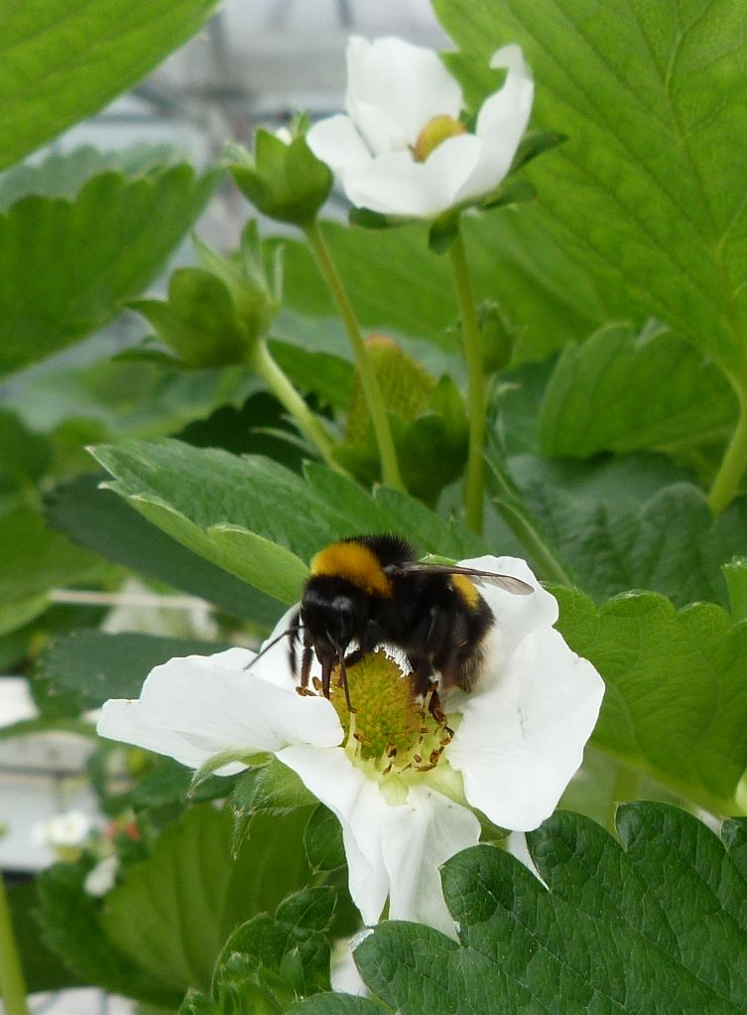
WHY SUPER-B ?
Sustainable Pollination in Europe:
joint Research on Bees and other pollinators
Crop pollination a key factor worth >140 Billion Euro globally
Bees are declining [honeybee and wild bee] → pollination services in danger
Knowledge on pollination and pollinator management is dispersed
Honeybee and wild bee community partly separated
Multifactorial problem [e.g. pests and pathogens, agricultural practice]
FOOD SECURITY
A GLOBAL CHALLENGE

Slide 3
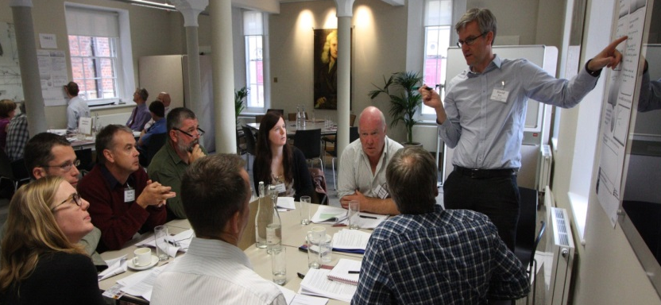
WHY SUPER-B ?
Sustainable Pollination in Europe:
joint Research on Bees and other pollinators
Need for sharing of scientific, technological and practical information between countries, regions and taxa
To speed up science, address emerging challenges, develop agricultural innovations
For better agricultural production and food security while conserving biodiversity.
A forum for standardization, a common database and information platform for knowledge and best practices for (crop) pollination.
FOOD SECURITY
A GLOBAL CHALLENGE

Slide 4
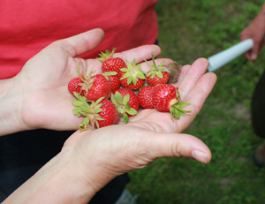
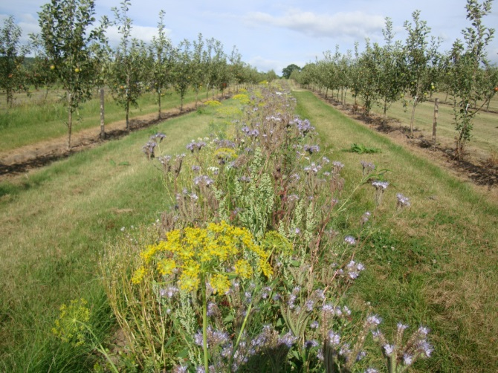
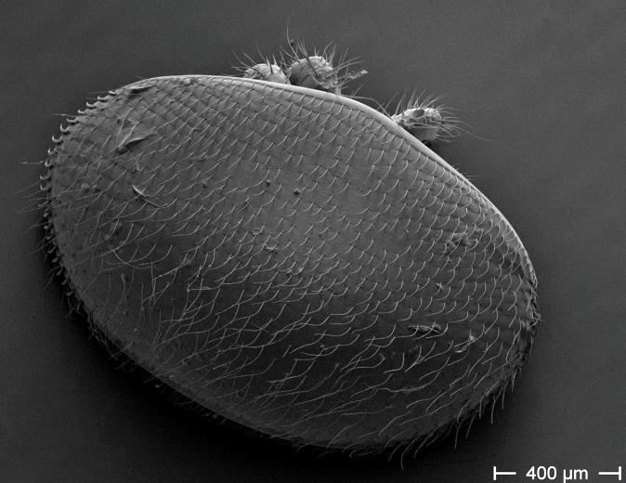
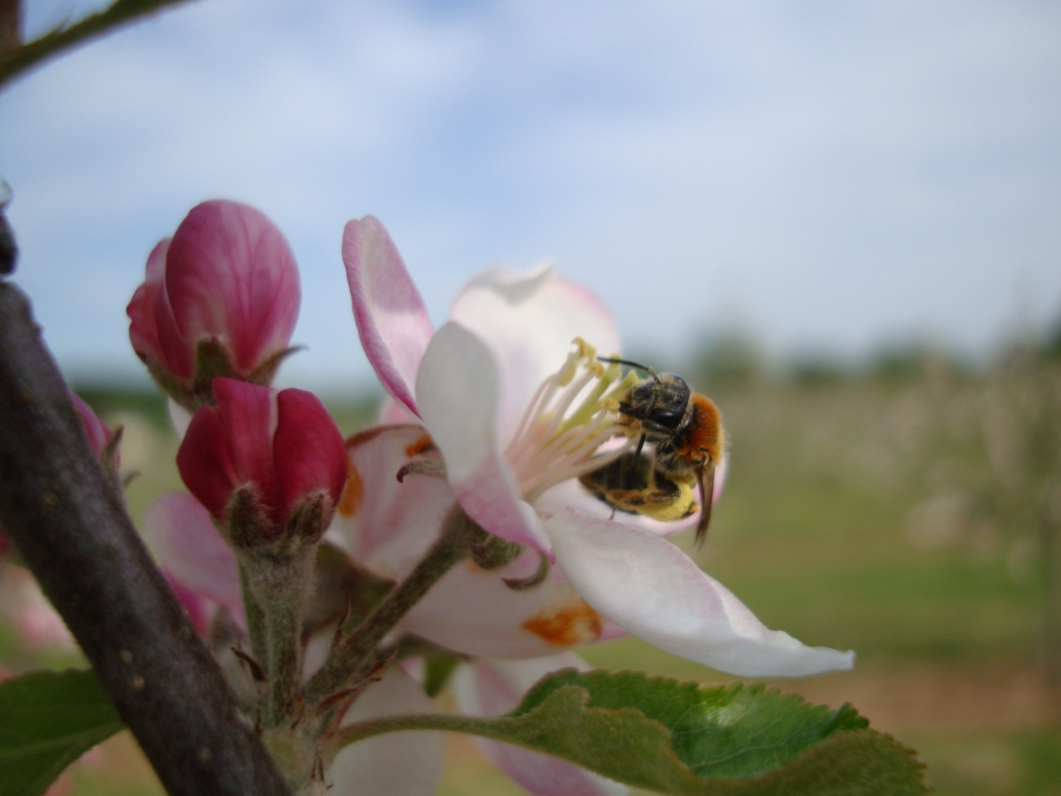

What will SUPER-B aim at ?
Improve production
Mitigation of loss
Drivers of loss
The main objective of the Action is to integrate knowledge and develop methods to underpin sustainable pollination services in Europe
Pollination research
Large network to share, develop and advice

Slide 5
SUPER-B Structure
64 members, 27 COST countries, 4 non-COST, FAO, IUCN, EU [40.6% ♀]
COORDINATION
Koos Biesmeijer ♂ [Netherlands] Peter Neumann ♂ [Switzerland]
Benefits of pollination services
Simon Potts
♂ [UK]
Mette Termansen
♀ [Denmark]
Pollination service delivery
Alex Klein
♀[Germany]
Luisa Carvalheiro
♀ [Portugal]
Mitigating pollination loss
David Kleijn
♂ [Netherlands]
Tjeerd Blacquiere
♂ [Netherlands]
Drivers of pollinator loss
Rob Paxton
♂ [Germany]
Marc Brown
♂ [UK]
EXECUTIVE COMMITTEE
Dissemination
Lyubomir Penev ♂ [Bulgaria] Llynn Dicks ♀ [UK]

Slide 6
SUPER-B Structure
64 members, 27 COST countries, 4 non-COST, FAO, IUCN, EU [40.6% ♀]
Management Committee
Nominations by MC can include a:
Financial Coordinator – responsible for COST reimbursement to Action members, and other financial matters.
Membership Coordinator –responsible for membership requests
Conference Coordinator
Meeting and Workshop Coordinator
Short-term Scientific Mission STSM Coordinator
Training School Coordinator
Early Stage Researcher (ESR) / gender equality adviser(s),
COORDINATION
Koos Biesmeijer ♂ [Netherlands] Peter Neumann ♂ [Switzerland]
Benefits of pollination services
Simon Potts
♂ [UK]
Mette Termansen
♀ [Denmark]
Pollination service delivery
Alex Klein
♀[Germany]
Luisa Carvalheiro
♀ [Portugal]
Mitigating pollination loss
David Kleijn
♂ [Netherlands]
Tjeerd Blacquiere
♂ [Netherlands]
Drivers of pollinator loss
Rob Paxton
♂ [Germany]
Marc Brown
♂ [UK]
EXECUTIVE COMMITTEE
Dissemination
Lyubomir Penev ♂ [Bulgaria] Llynn Dicks ♀ [UK]

Slide 7
SUPER-B will address:
Establish crop pollination as an agricultural input
- Quantify relative contributions of insect pollination to crop production
- Understand the barriers and incentives to farmers embedding pollination into standard practices
- Develop key messages and case studies to underpin multi-media materials to enable pollination to be taken into account in European agriculture decision making.
WP 1
Benefits of pollination services
Simon Potts
♂ [UK]
Mette Termansen
♀ [Denmark]
Establish the wider benefits of pollinators and pollination for ecosystem service provision
Review the evidence for the aesthetic, recreational and cultural values derived from pollinators and pollination services
Explore ways to integrate pollination into the activities of land managers, conservationists, policy advisors, industry, planners and the general public.

Slide 8

SUPER-B will address:
Assess variability of main pollinators across different crops and regions
Compile information on pollinator management practices
WP 2
Pollination service delivery
Alex Klein
♀[Germany]
Luisa Carvalheiro
♀ [Portugal]
Synthesize available evidence on the importance of pollinator diversity across crops and regions
Identification of synergies and trade-offs in service delivery between wild and managed pollinators

Slide 9

SUPER-B will address:
Linking pollinator mitigation to pollination mitigation
WP 3
Uptake vs availability of measures as the key to effective mitigation of pollination loss
Mitigating pollination loss
David Kleijn
♂ [Netherlands]
Tjeerd Blacquiere
♂ [Netherlands]
Mitigation measure synergies between managed and wild pollinators

Slide 10
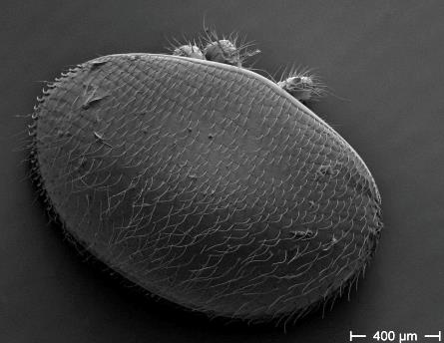
SUPER-B will address:
Determine whether managed and wild bee populations respond differentially to drivers
Determine whether the major drivers identified in Task 1 act differentially across European climatic zones
WP 4
Drivers of pollinator loss
Rob Paxton
♂ [Germany]
Marc Brown
♂ [UK]
Develop a modelling approach to predict how changes in major drivers and their interactions will impact wild and managed bee populations and the service provision of pollination

Slide 11
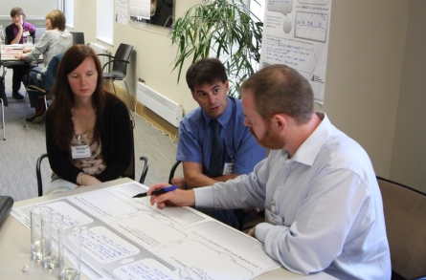
SUPER-B dissemination plan
Website with dedicated stakeholder section and materials
Research-stakeholder agenda-setting workshop
Workshop to identify policy opportunities
Outreach training for scientists
Build partnerships between farmers, business, beekeepers, professionals
…and much more
Dissemination
Plan
Lyubomir Penev ♂ [Bulgaria]
Llynn Dicks ♀ [UK]

Slide 12
SUPER-B Structure
64 members, 27 COST countries, 4 non-COST, FAO, IUCN, EU [40.6% ♀]
COORDINATION
Koos Biesmeijer ♂ [Netherlands] Peter Neumann ♂ [Switzerland]
Benefits of pollination services
Simon Potts
♂ [UK]
Mette Termansen
♀ [Denmark]
Pollination service delivery
Alex Klein
♀[Germany]
Luisa Carvalheiro
♀ [Portugal]
Mitigating pollination loss
David Kleijn
♂ [Netherlands]
Tjeerd Blacquiere
♂ [Netherlands]
Drivers of pollinator loss
Rob Paxton
♂ [Germany]
Marc Brown
♂ [UK]
EXECUTIVE COMMITTEE
Dissemination
Lyubomir Penev ♂ [Bulgaria] Llynn Dicks ♀ [UK]

Slide 13
SUPER-B
Sustainable Pollination in Europe:
joint Research on Bees and other pollinators
Specifically, the Action will
(1) identify the role of insect pollination in agriculture and other ecosystems;
(2) clarify best practices for mitigation of pollination loss, and
(3) compare and contrast important drivers of pollinator loss (wild and managed species).
SUPER-B will contribute towards maintaining natural ecosystems and achieving sustainable use of pollinators in agricultural production.

Slide 14
SUPER-B
Why apply for COST funding?
COST is the obvious choice for funding this action, which emphasises the formation of an extensive
scientific-practitioner network to join on-going, but dispersed, research and management efforts,
to set standards and define clear measures and
to disseminate higher-level outcomes to relevant scientific
disciplines, stakeholders in farming and policy-making.
The European landscape contains many of the critical
parts of the sustainable pollination challenge but requires a high level convening and coordinating mechanism
to achieve maximum value from these currently disparate components.

Slide 15








SUPER-B: positioning
STEP
[FP7]
LIBERATION
[FP7]
COLOSS
[COST]
SUPER-B
FAO
International
Pollinator
Initiative
BEEDOC
[FP7]

Slide 16




SUPER-B of interest to industry ?
Syngenta, Bayer, Koppert, and BioBest showed interest in Super-B in development phase
Peter Sutton: “ I confirm that Syngenta Ltd is keen to be a partner in this network. We believe that it will really help to better understand and sustain pollination services in the rural landscape. It is important to Syngenta’s crop protection and seeds business in Europe and globally.
Christian Maus: “ I would like to confirm that Bayer would be interested in being involved in the SUPER-B Project. We would be interested in an involvement in the SUPER-B project.
Our commitment for pollinator protection has just recently manifested in the buildup of a new department, the Bayer Bee Care Center”

Slide 17


The National Farmer's Union is keen to be involved in the SUPER-B network because in representing farmers, growers and commercial beekeepers, we have a fundamental interest in pollination services and the need to better understand the threats to those services, the value of those services, and the opportunities to undertake measures within agricultural landscapes that will improve the prospects for insect pollinators. It is clear that pollinator services have a key role to play in food security, and measures to conserve and enhance these services should sit within wider strategies to produce more agricultural output while impacting less on the environment. It is important that any measures and best practice to mitigate pollinator loss are effective, practical to implement and sustainable - not just environmentally but also in terms economic sustainability for those implementing and affected by these actions on the ground. Accordingly the NFU would be keen to participate in the proposed SUPER-B working groups. We believe that effective communication of balanced evidence-based information is a critical part of this proposal - first and foremost to ensure that the public and policy-makers have a basic but factually-correct and balanced understanding of the science. It is also important for farmers, growers and agronomists to have a clearer understanding of the value of pollinator services to farming businesses and a clear understanding of proven cost-effective measures that will effectively maintain or enhance the provision of those services. Accordingly the NFU would be willing to use its existing networks to communicate information from SUPER-B to our members and others (the NFU has 56,000 farmer and grower members, and 40,000 Countryside members - who are people interested in rural issues).
I confirm that Syngenta Ltd is keen to be a partner in this network. We believe that …it will really help to better understand and sustain pollination services in the rural landscape. It is important to Syngenta’s crop protection and seeds business in Europe and globally.

Slide 18


Statement of support from ECPA
ECPA is keen to be involved in the SUPER-B network in recognition of the potential value of SUPER-B for improving understanding of the drivers of pollinator health and thereby better enabling action to improve conditions for an essential ecosystem service, and addressing delivery of sustainable productive agriculture in Europe.
"IUCN- International Union for Conservation of Nature is keen to be involved in SUPER-B network because we consider this project to be crucial as it will identify key pollinators in Europe, contribute to its conservation and highlight their importance to the economy and society. IUCN, being the largest global environmental network with expertise in providing scientific knowledge to policy makers in order to help make informed decisions, will be mainly involved in the implementation of the dissemination plan of the project and will take the lead on the delivery of the policy oriented events and on translating scientific project outcomes into policy recommendations. IUCN is knowledgeable of EU biodiversity policies and have strong connections with the European institutions.”

Slide 19
SUPER-B
Scientific Deliverables
1) The establishment and developments of novel crop pollination management guidelines to be incorporated as
a recognised agricultural input for pollinator-dependent cropping systems; this will be based on an initial
analysis of stakeholder questions and needs.
2) An assessment of current crop pollination deficits, stability and resilience in major European crop species
and varieties; along with standardised field and laboratory research methods for surveying and monitoring
crop pollination success and wild pollinator communities;
3) The intensified use of managed bees, particularly bumblebees (Bombus terrestris) and mason bees (Osmia
bicornis and Osmia cornuta) as effective and safe commercial crop pollination organisms;
4) A review of methods to effectively mitigate loss of pollination service for European crops, accounting for
differences in landscape, farming system and uptake of measures;
5) The quantification of the relative contribution, individually and in combination, of factors driving declines
in major crop and wild flower pollinators, with a focus on pathogens, nutrition, agrochemicals and human
management;
6) Improved wild pollinator conservation practice, both the measures themselves and their uptake, and policy
by inter- and transdisciplinary actions ;
7) Providing robust evidence where current and emerging pollinator-related policies are lacking support (e.g.
pesticide regulations).

Slide 20
The main objective of the Action is to integrate knowledge and develop methods to underpin sustainable
pollination services in Europe
1) Establish pollination service as a recognised agricultural input;
2) Identify synergies and trade-offs in service delivery between wild and managed pollinators;
3) Publish standardized methods for crop pollination, pollinator use and monitoring tools for scientific and
societal communities that allows for comparison of countries and cropping systems; as well as best
practices for managed pollinator use, particularly bumblebees and mason bees;
4) Provide an overview of methods to effectively mitigate loss of pollination services in different
European crops and (semi-)natural habitats; identify how uptake of these methods can be improved;
5) Develop a pan-European standardized survey of driver impacts, including pathogen loads in managed
and wild pollinators;
6) Ensure more reliable and stable pollination service delivery for European crops and wild plants.

Slide 21
Your presentation should provide the following information:
--the scientific deliverables and key objectives, i.e. what new advances and developments will the network bring and what is the added value, the impact, of such a network.
--New advances could be in terms of scientific and technological developments, advances in standardisation and regulation.
--Would these advancements be of interest for the industry?
--why is COST the best mechanism?
--how will the objectives and anticipated impact be achieved, e.g. through organisation of major meetings (xxx), training schools, dissemination; structure and management of the project;
--No need for repetition of descriptions of gender balance, numbers of meetings, publications etc.
--I would like to advise you to pay special attention to the comments and recommendations made by the External Experts Panel.

Slide 22
Other points of critique that seem to be key, and that need to be addressed, are:
• integrating across other ecosystem services and integrating with other stakeholder goals (e.g. yields of crops for farmers). Answer: we are aware of the need to integrate across ES's (recent TREE review by Simon et al.) and shall integrate reviewer comments into philosophy of the network. But at the end of the day we need to understand well the dynamics of pollination if we are to stand any chance of integrating it with other ES's and wider goals.
• reach out to policy makers. Answer: this is really important. Can you give examples of how the team does so e.g. Simon's current engagement with the UK government on pollination and his and my involvement in FERA's 'healthy bees' plan.
B.3. 6 of possible 8 stakeholder involvement plans are clear and wide-ranging instead of stakeholders were part of the proposal preparation (which they partly were in our case)
Well, the review comments already pointed out: Experts such as policy makers, scientists, NGOs, producers and industrial partners have taken part in the preparation of this proposal.
So I think some reviewers already acknowledged that Super_B did integrate stakeholders into the proposal.
LYNN:
For example, I consulted with the UK National Farmer's Union, and the Portguese Beekeeper's National Federation, the Sustainability Assessment Unit of the European Commission, the IUCN and the European Crop Protection Association (ECPA). I have email correspondence and/or written statements of support from these organisations, which I think you have.
So the line to take is that we did consult with key stakeholders and they were directly involved in preparing the proposal. It would be good to have a specific example of where this consultation changed the proposal itself. Some possibilities:
ECPA suggested we include the EU Reference Laboratory on bee health (not sure if this made it in) , and also asked that the project plan "makes a better link between relevant ecosystem service delivery (i.e. pollination services) and sustainable productivity in agriculture"
IUCN were very enthusiastic about the stakeholder engagement plan and offered to run one of the key workshops
The UK National Farmer's Union agreed to provide access to its networks.
The ECPA were particularly involved. I had a teleconference with four of its staff about SuperB.

Slide 23

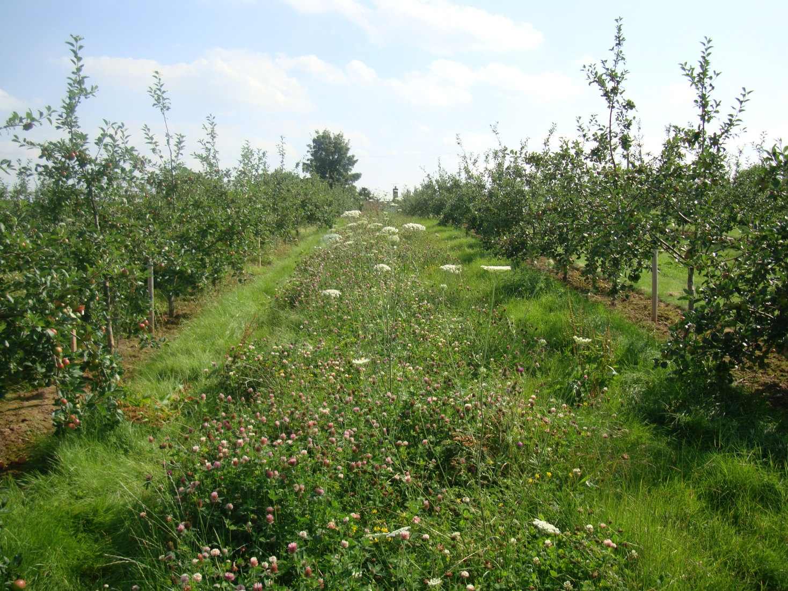
© Al Campbell

Slide 24
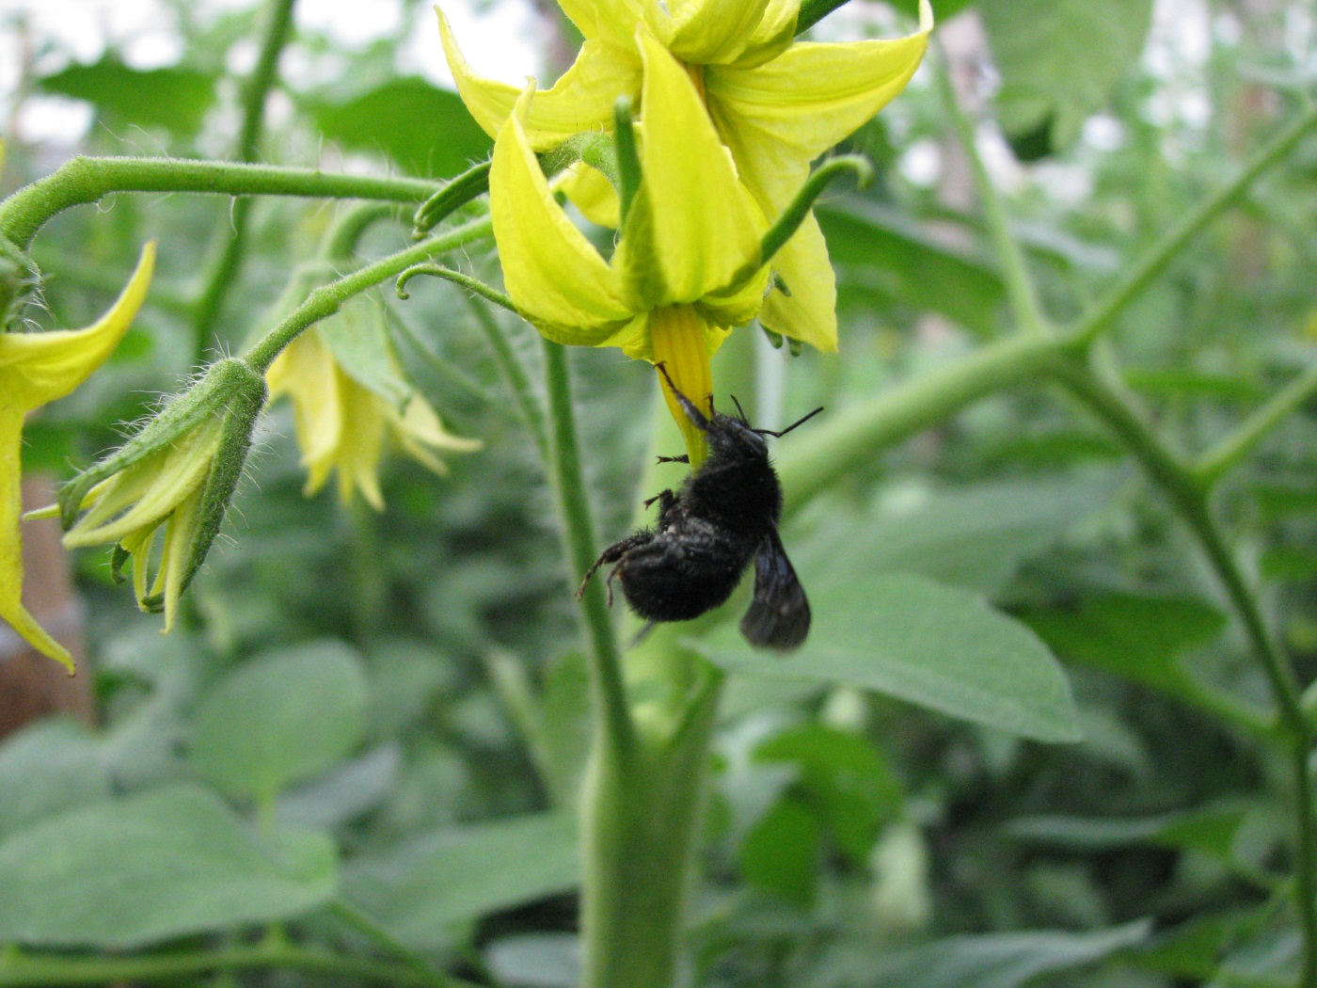

Slide 25
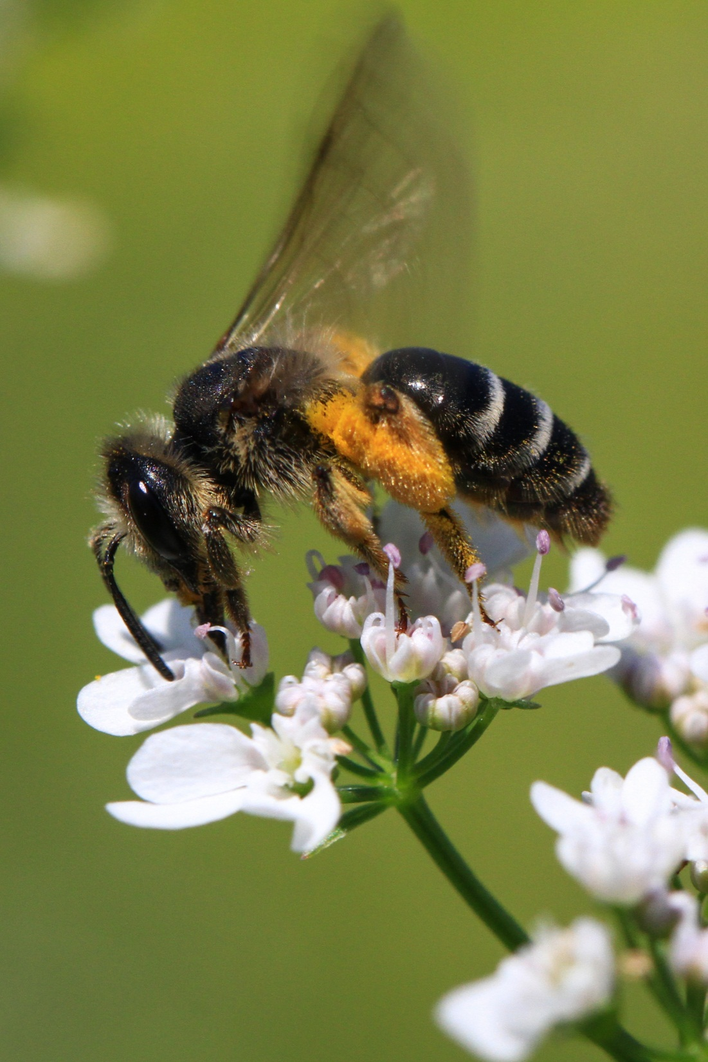
Wild bee on Coriander © Matthias Albrecht

Slide 26
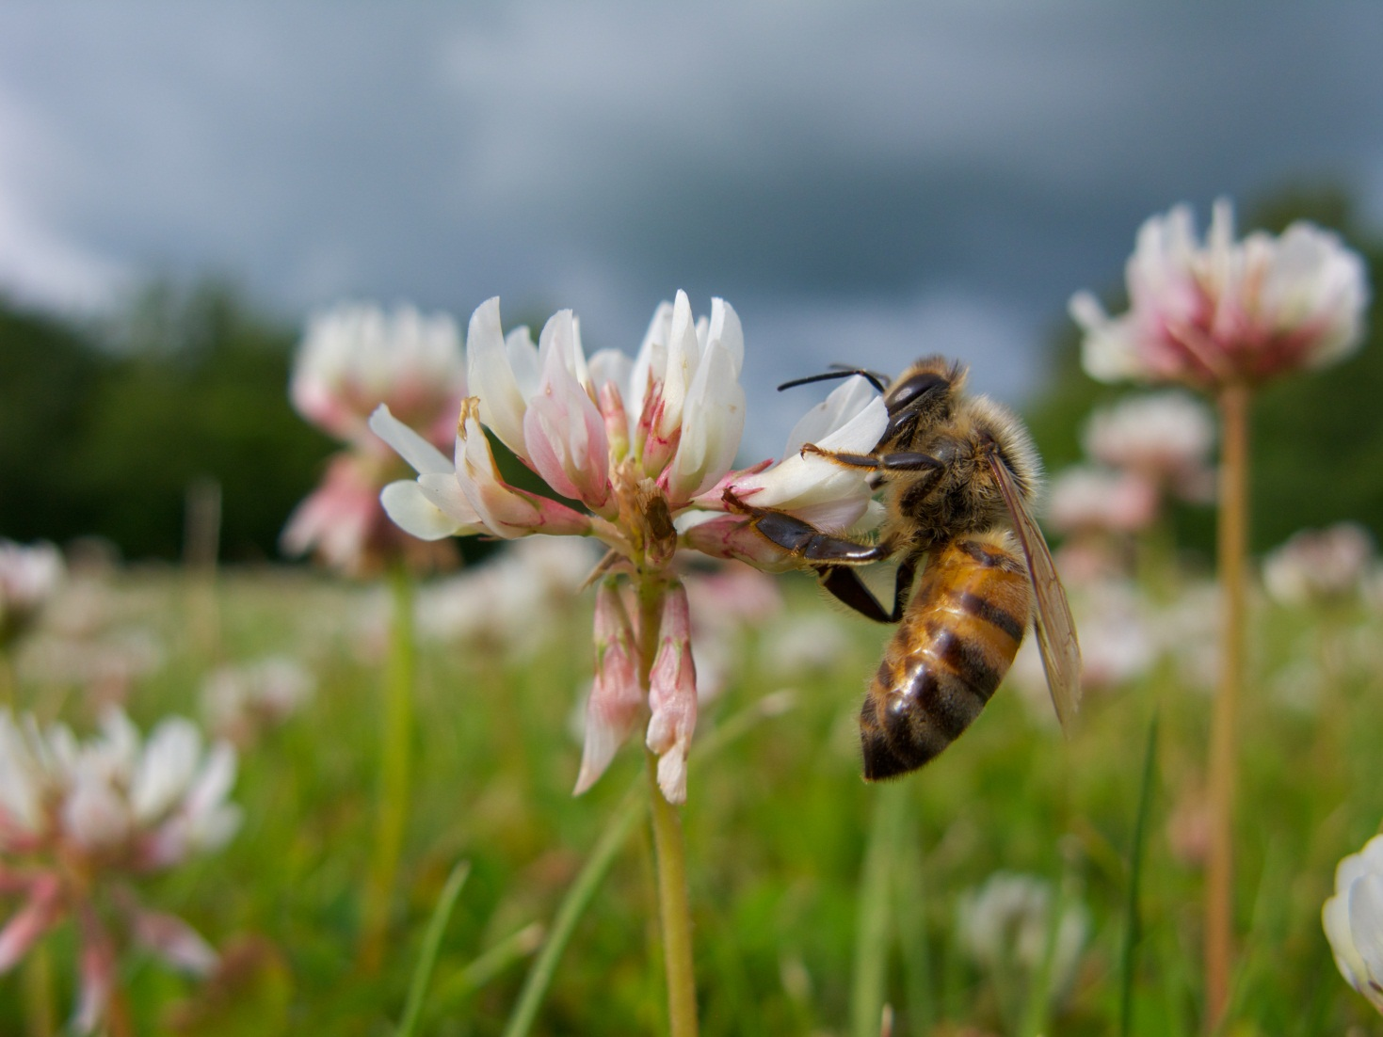
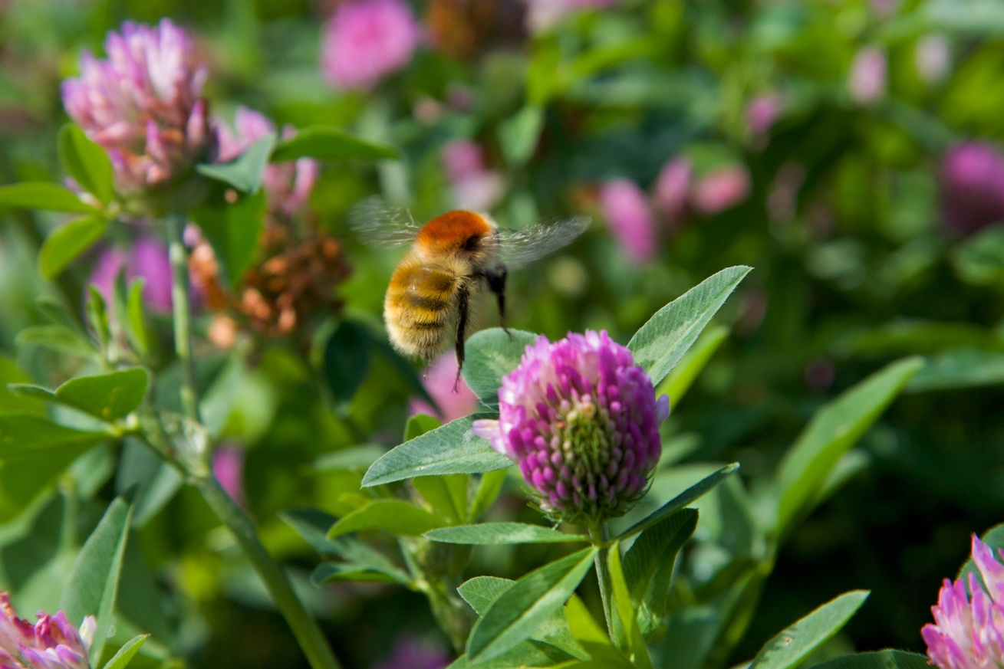
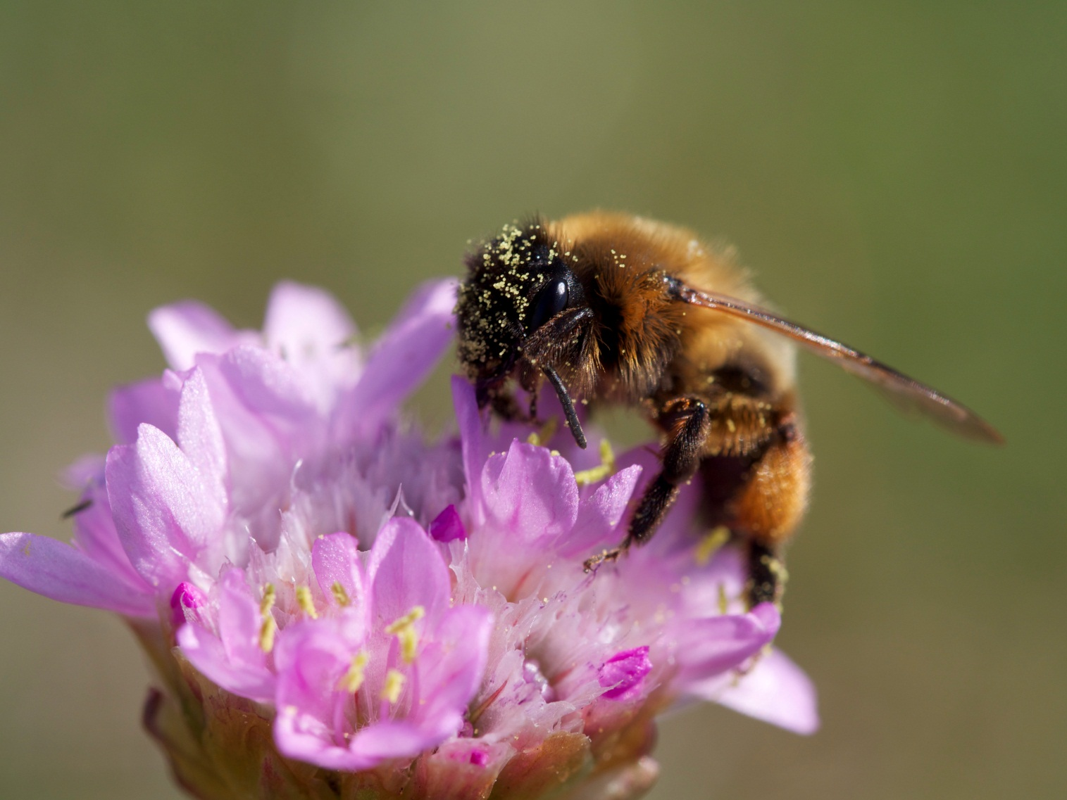
© Per Kryger

Slide 27
© Marika Mand

Slide 28

Attached are a few pictures of scientists and stakeholders working together developing projects to address priority knowledge needs. The one I most often use is number 7554, because it shows Nigel Raine and Eileen Power (two IPI scientists) discussing pesticide exposure issues with Julian Little from Bayer Crop Science. If you choose one of the others, I can let you know exactly who is in it and what they were discussing if needed.

Slide 29


Slide 30
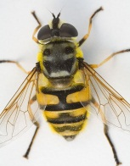
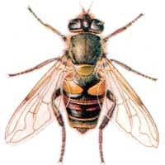
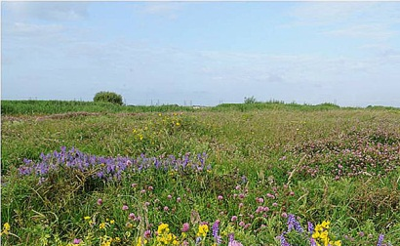
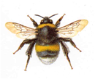


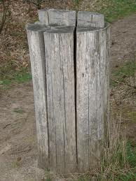
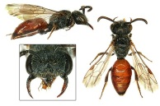
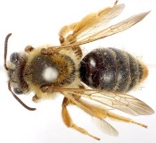
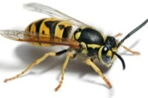
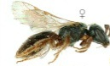
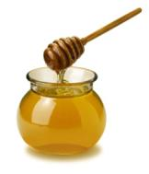
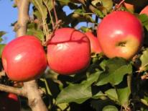
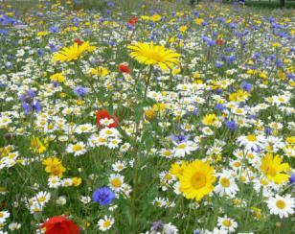
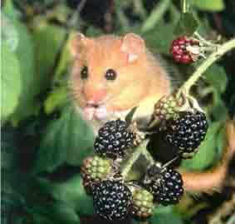
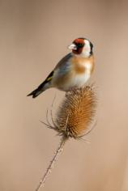
Het grote probleem:
achteruitgang van bestuivers
1
+
>500
BESTUIVERS
ECOSYSTEEMDIENSTEN
voedsel
bestuiving
gewassen
bestuiving
80% wilde planten
€
€ € € € € € € € € € € € € € € € € € € € €
€ € € € € €
....

Slide 31
