Slide 1

Koos Biesmeijer

Slide 2
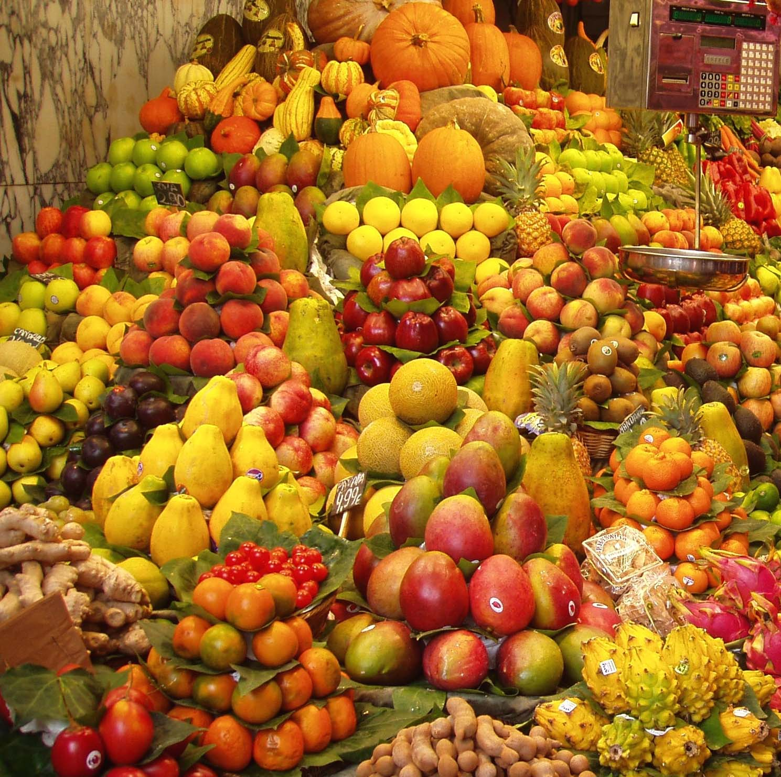
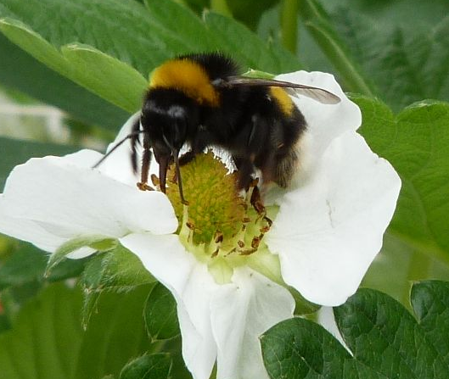
WHY SUPER-B ?
Sustainable Pollination in Europe:
joint Research on Bees and other pollinators
Crop pollination a key factor worth >140 Billion Euro globally
If bees are insufficient [honeybee and wild bee] → pollination services may be insufficient
Knowledge on pollination and pollinator management is dispersed
Honeybee and wild bee community partly separated
Multifactorial problem [e.g. pests and pathogens, agricultural practice, conservation, climate change]
FOOD SECURITY
A GLOBAL CHALLENGE
Super-b@naturalis.nl

Slide 3
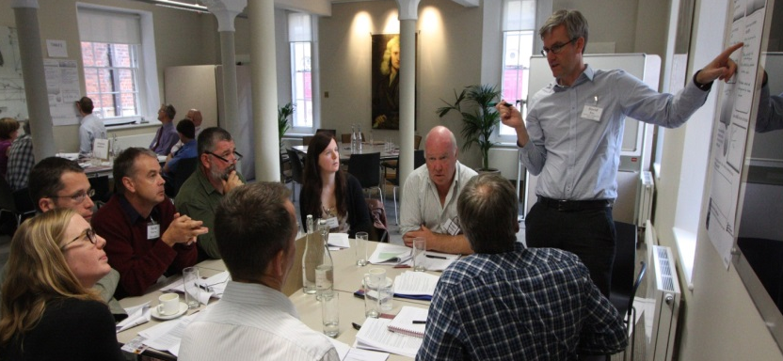
WHY SUPER-B ?
Sustainable Pollination in Europe:
joint Research on Bees and other pollinators
Need for sharing of scientific, technological and practical information between countries, regions and taxa
To speed up science, address emerging challenges, develop agricultural innovations
For improved agricultural production and food security while conserving biodiversity.
A forum for standardization, shared information platform for knowledge and best practices for (crop) pollination.
FOOD SECURITY
A GLOBAL CHALLENGE
Super-b@naturalis.nl

Slide 4
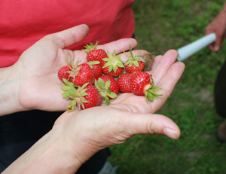
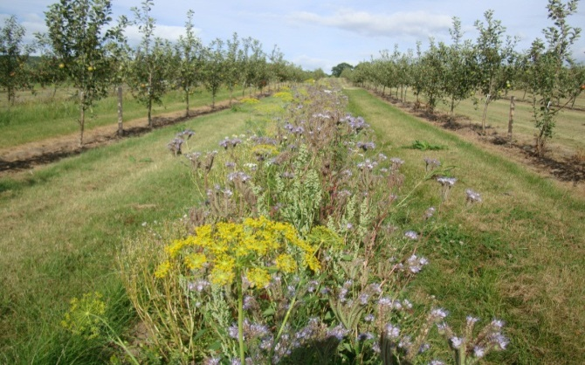
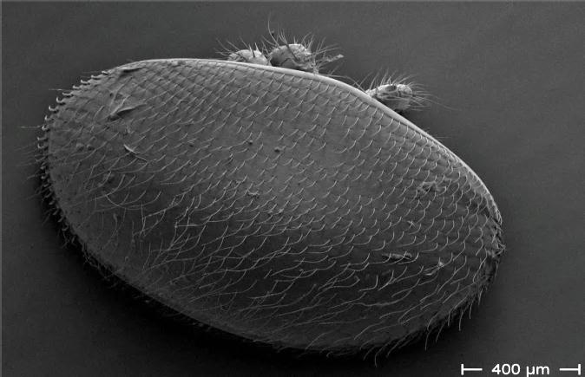
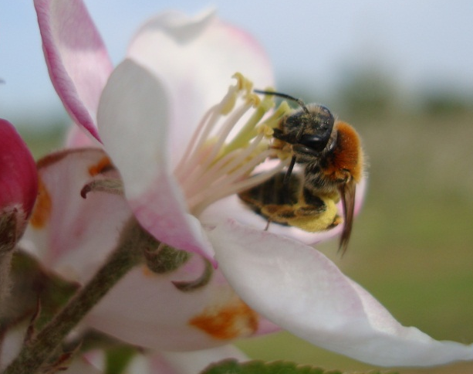

What will SUPER-B aim at ?
Improve pollination-derived services
Mitigation of loss
Drivers of loss
The main objective of the Action is to integrate knowledge and develop methods to underpin sustainable pollination services in Europe
Pollination research
Large network to share, tackle and develop
Super-b@naturalis.nl

Slide 5
SUPER-B Structure proposed
>60 members, >26 COST countries, 4 non-COST,
FAO, IUCN, EU, Syngenta, NFU, Koppert, Bayer, Bio-Best, ….
Olga Crapels
COORDINATION
Koos Biesmeijer [Netherlands] Peter Neumann [Switzerland]
Benefits of pollination services
Mette Termansen
[Denmark]
Simon Potts
[UK]
Pollination service delivery
Alex Klein
[Germany]
Luisa Carvalheiro
[Portugal]
Mitigating pollination loss
David Kleijn
[Netherlands]
Tjeerd Blacquiere
[Netherlands]
Drivers of pollinator loss
Marc Brown
[UK]
Rob Paxton
[Germany]
EXECUTIVE COMMITTEE
Dissemination
Lynn Dicks [UK] Lyubomir Penev [Bulgaria]
Super-b@naturalis.nl

Slide 6








SUPER-B: positioning
STEP
[FP7]
LIBERATION
[FP7]
COLOSS
[COST]
SUPER-B
SUPER-B: [First] network with integrative and multidisciplinary focus on pollination services
FAO
International
Pollinator
Initiative
BEEDOC
[FP7]
ADD YOUR PROJECT!!
Super-b@naturalis.nl

Slide 7
SUPER-B will address:
Establish crop pollination as an agricultural input
- Quantify relative contributions of insect pollination to crop production
- Understand the barriers and incentives to farmers embedding pollination into standard practices
- Develop key messages and case studies to underpin multi-media materials to enable pollination to be taken into account in European agriculture decision making.
WG 1
Benefits of pollination services
Mette Termansen
[Denmark]
Simon Potts [UK]
Establish the wider benefits of pollinators and pollination for ecosystem service provision
Review the evidence for the aesthetic, recreational and cultural values derived from pollinators and pollination services
Explore ways to integrate pollination into the activities of land managers, conservationists, policy advisors, industry, planners and the general public.
Super-b@naturalis.nl

Slide 8

SUPER-B will address:
Assess variability of main pollinators across different crops and regions
Compile information on pollinator management practices [wild and managed spp]
WG 2
Pollination service delivery
Alex Klein
[Germany]
Luisa Carvalheiro
[Portugal]
Synthesize available evidence on the importance of pollinator diversity across crops and regions
Identify synergies and trade-offs in service delivery between wild and managed pollinators
Assess role of pollination for wild plants and biodiversity conservation
Super-b@naturalis.nl

Slide 9

SUPER-B will address:
Linking pollinator mitigation to pollination mitigation
[e.g. Apis hives, flower margins, habitat]
WP 3
Uptake vs availability of measures as the key to effective mitigation of pollination loss
Mitigating pollination loss
David Kleijn
[Netherlands]
Tjeerd Blacquiere
[Netherlands]
Mitigation measure synergies and trade-offs between managed and wild pollinators
Super-b@naturalis.nl

Slide 10
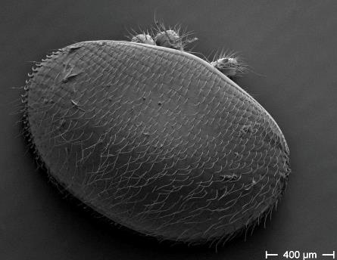
SUPER-B will address:
Determine whether managed and wild pollinator populations respond differentially to drivers
Determine whether the major drivers identified above act differentially across European climatic zones
WP 4
Drivers of pollinator loss
Marc Brown
[UK]
Rob Paxton
[Germany]
Develop monitoring protocols and a modelling approach to assess and predict how changes in major drivers and their interactions will impact wild and managed bee populations and the service provision of pollination
Super-b@naturalis.nl

Slide 11
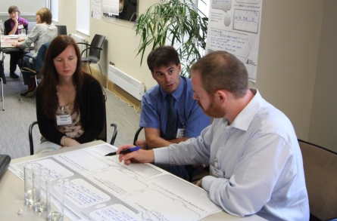
SUPER-B dissemination plan
Website with dedicated stakeholder section and materials
Research-stakeholder agenda-setting workshop
Workshop to identify policy opportunities
Outreach training for scientists
Build partnerships between farmers, business, beekeepers, professionals
…and much more
Dissemination
Plan
Lynn Dicks
[UK]
Lyubomir Penev [Bulgaria]
Super-b@naturalis.nl

Slide 12
SUPER-B will deliver:
1) Novel crop pollination management guidelines to be incorporated as a recognised agricultural input for pollinator-dependent cropping systems
2) Assessment of current crop pollination deficits, stability and resilience in major European crop species and varieties
3) Standards for field and laboratory research methods for surveying and monitoring crop pollination success and wild pollinator communities;
3) Improved use of managed bees, particularly bumblebees and mason bees as effective and safe commercial crop pollination organisms
4) A review of methods to effectively mitigate loss of pollination service for European crops, e.g. for differences in landscape, farming system and uptake of measures;
5) Quantify the relative contribution, individually and in combination, of factors driving declines, with a focus on pathogens, nutrition, agrochemicals and human activities;
6) Improved wild pollinator conservation practice,
7) Providing robust evidence where current and emerging pollinator-related policies are lacking support (e.g. pesticide regulations).
My ambition with Super-B:
I hope that in 2018 Super-B activities have filled important knowledge gaps in pollination research. Researchers across the EU are aware of each other’s work and results. Crop farmers want to know about pollination, know where to get relevant information, and know how to manage their systems for optimal pollination services. Policy-makers and land managers take conservation measures for pollination and pollinators into account in their programs. And the general public is more aware of how pollinators contribute to our food security and well-being.
What is your ambition?
What is our ambition?
Super-b@naturalis.nl

Slide 13
What do you want with Super-B?
Your ambition: top 3 goals within Super-B
→ Email us on super-b@naturalis.nl !
Use Super-B as a catalyst to start other projects
At national levels (additional funding possible?)
With other stakeholders (growers, industry, government)
Join in, share your expertise and collaborate!
Super-b@naturalis.nl

Slide 14
SUPER-B tools
Website as a focal information and dissemination point
Coordination of action:
MC meetings, clear working group structure,
Annual planning and reporting cycle
Open structure, stimulating spin-off activities and projects
Advance scientific interaction through:
- Annual conferences linked to planned scientific meetings
- STSMs and dedicated workshops/training events
Advance science-society-policy interaction through:
REACHING OUT: Stakeholder workshops, Policy makers workshop
Develop partnerships: science, farming, business, policy
Dedicated dissemination program
Super-b@naturalis.nl

Slide 15
What we expect from MC members:
Actively participate in Super-B
→ Email us on super-b@naturalis.nl !
Indicate in which Working Group your main activities will be,
what expertise will you bring in
Contribute to Super-B administrative roles:
STSM coordinator
Equality and diversity advisor (Gender, Countries, …)
ESR – Early Stage Researchers coordinator
….
Organize activities & spread the word
Super-b@naturalis.nl

Slide 16
Towards an Action Plan
and Budget for year 1
Aim to finish it by mid-May
WG leads make a plan for their WG
based on MoU and your contributions
Chair collates information, calculates budget, consults WG leads + EC about prioritization
Chair drafts year 1 Action Plan and Budget
WG-leads correct the draft
Chair submits Action Plan and Budget to COST
Super-b@naturalis.nl

Slide 17
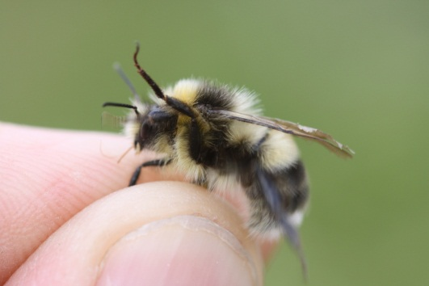
Task for each Working Group:
Define the road to reach our objectives
Are the main tasks [in MoU] the best and only ones?
What are the means to complete them?
  STSM
  Training
  Workshop
  Conference
What is the timeline over the four years?
(step 1,2,3 towards the objective)
Super-b@naturalis.nl

Slide 18
YEAR 1
MC
CONF
WORK
SHOP
STSM
TRAIN
DELIV
WG1
WG2
WG3
WG4
DISS
WEBSITE
COORDINATION

Slide 19
NEXT MC MEETING ?
MC + Workshops + Training ?
Link to ongoing meeting ?
Location ? Time ?
Super-b@naturalis.nl

Slide 20
I will send you an email with what we agreed, what is expected from you and the schedule for your input
Questions now ?
later: email: super-b@naturalis.nl
Super-b@naturalis.nl

Slide 21
Example of what we can do:
General costs:
15% Coordination
Website Yr1: 4500, Yr2-4: 1000/yr
MC meeting | €700/2d | 50pp | 35.000
WG meeting | €700/2d | 20pp | 14.000
Local organiser | 2000 |  | 2.000
Training event
trainer | 800 | 3 | 2.400
Trainee | 650 | 20 | 13.000
Local organ. | 2500 |  | 2.500
STSM | 1700/26d | 5 | 8.500
 | 1000/10d | 10 | 10.000

