Slide 1


Koos
Biesmeijer
Super-b@naturalis.nl

Slide 2
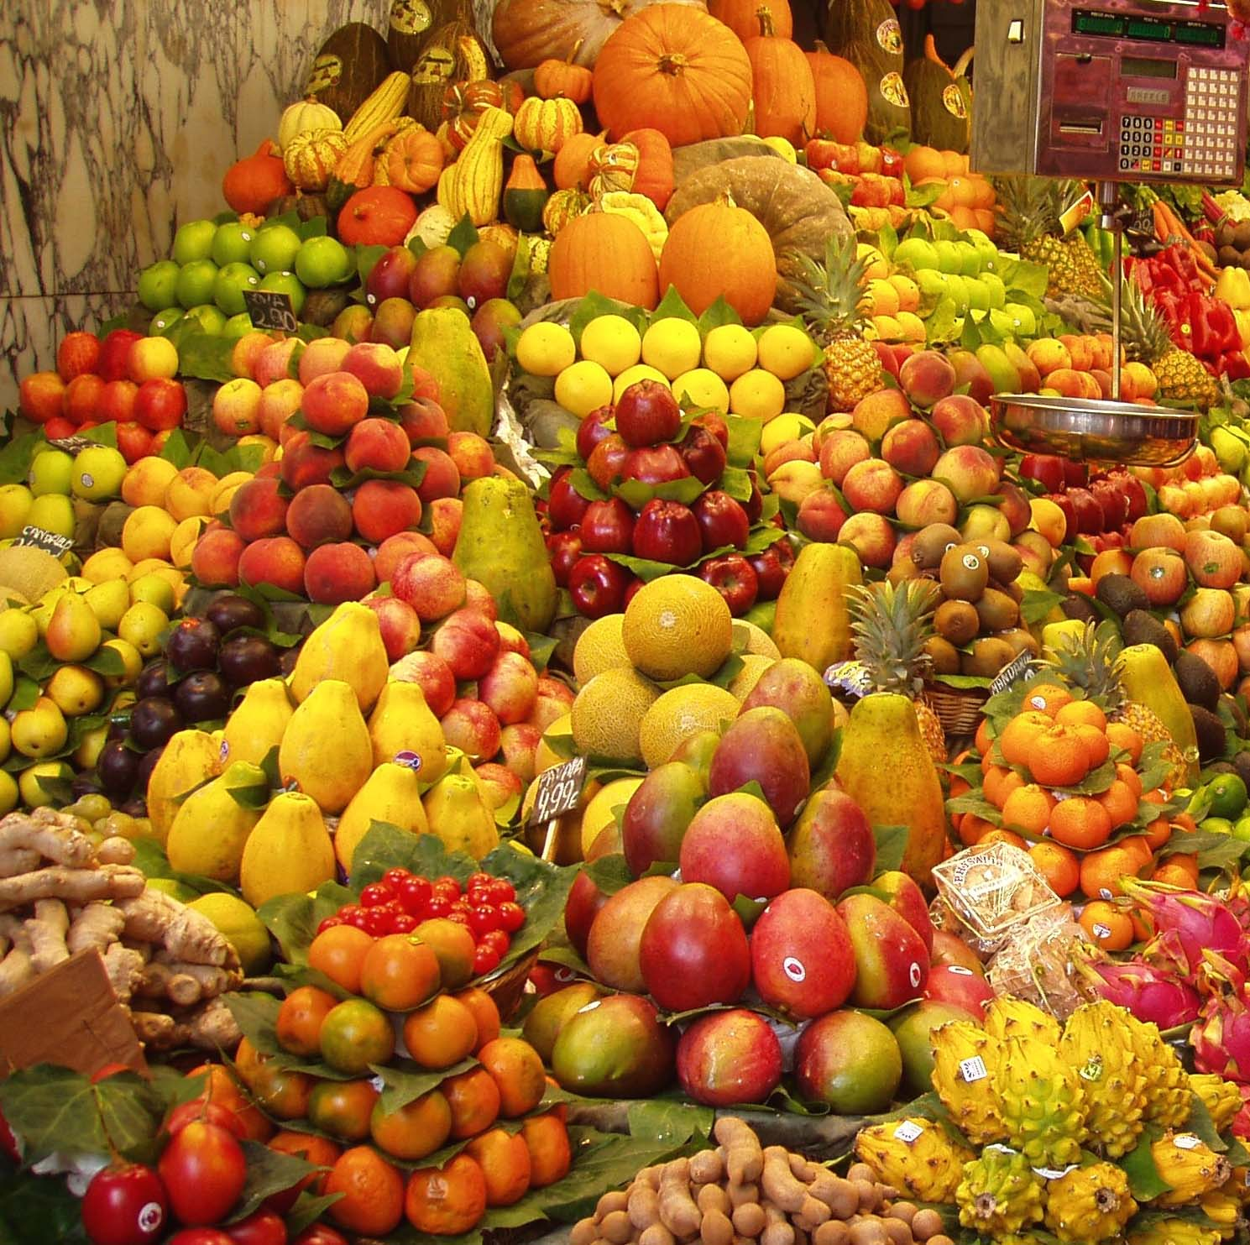
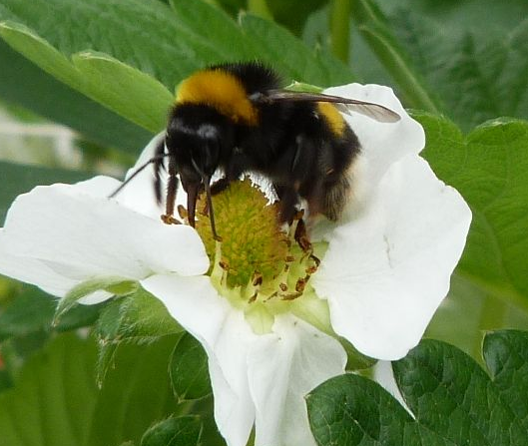
WHY SUPER-B ?
Sustainable Pollination in Europe:
joint Research on Bees and other pollinators
Crop pollination is important
>140 Billion Euro globally / yr
2/3 of crop species need pollination
Bees are declining → pollination services in danger ?!
[wild bees and managed bees]
Knowledge on pollination and pollinator management is dispersed
Multifactorial problem
[e.g. pests and pathogens, agricultural practice, economics, climate change]
FOOD SECURITY
A GLOBAL CHALLENGE
Super-b@naturalis.nl

Slide 3
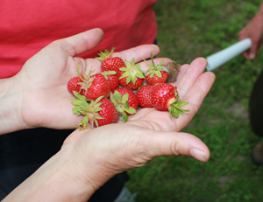
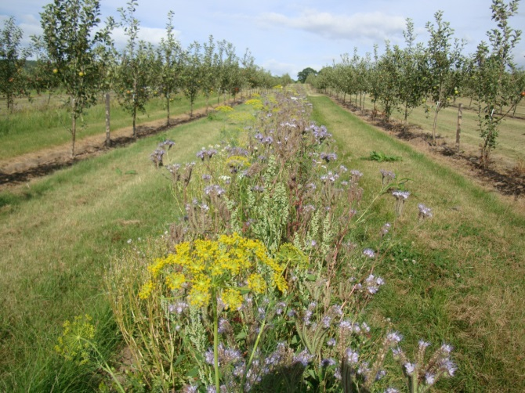
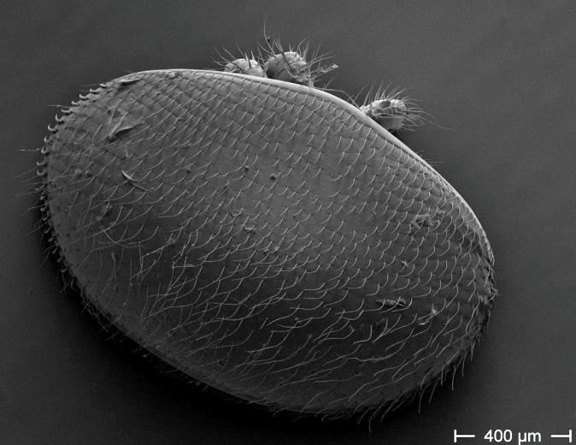
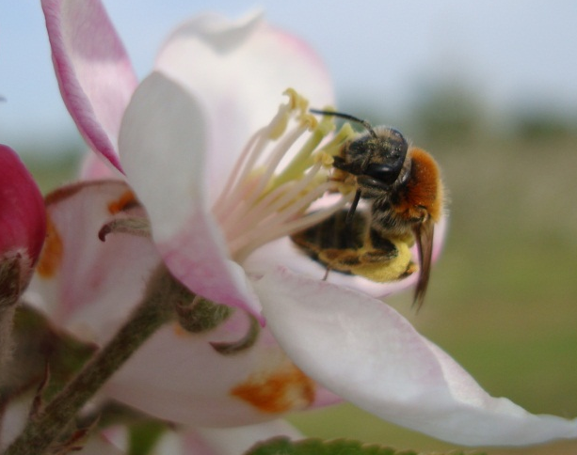
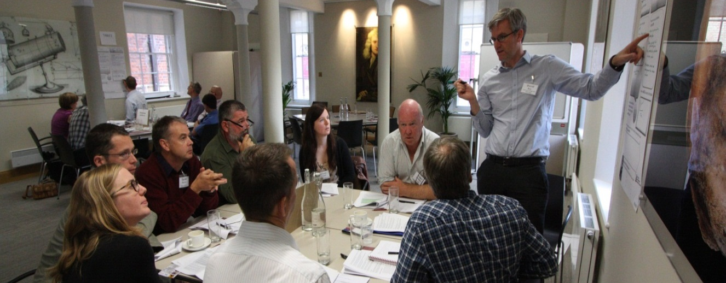
What will SUPER-B aim at ?
Improve production
Mitigation of loss
Drivers of loss
The main objective of the Action is to integrate knowledge and develop methods to underpin sustainable pollination services in Europe
Pollination research
Large network to share, develop and advice
Super-b@naturalis.nl

Slide 4
SUPER-B will address:
Establish crop pollination
as an agricultural input
Pollinators and pollination for ecosystem service provision
[e.g. wild plant pollination, recreation]
WP 1
Benefits of pollination services
Mette Termansen
[Denmark]
Simon Potts
[UK]
Super-b@naturalis.nl

Slide 5

SUPER-B will address:
Assess who pollinates what,
where and when
Compile information on pollinator management practices
WP 2
Pollination service delivery
Alex Klein
[Germany]
Luisa Carvalheiro
[Portugal]
Synthesize available evidence on the importance of pollinator diversity
Identify synergies and trade-offs in service delivery between wild and managed pollinators
Super-b@naturalis.nl

Slide 6

SUPER-B will address:
Link pollinator mitigation to pollination mitigation
WP 3
Uptake vs availability of measures for effective mitigation of pollination loss
Mitigating pollination loss
David Kleijn
[Netherlands]
Tjeerd Blacquiere
[Netherlands]
Mitigation measure synergies between managed and wild pollinators
Super-b@naturalis.nl

Slide 7
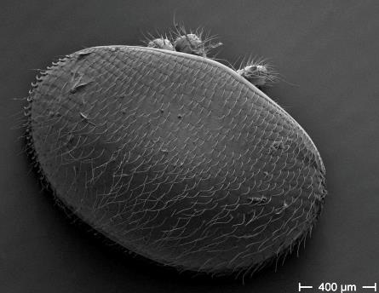
SUPER-B will address:
Do different drivers changes managed and wild bee populations ?
Driver importance across European climatic zones
WP 4
Drivers of pollinator loss
Rob Paxton
[Germany]
Marc Brown
[UK]
Develop models to predict how drivers impact wild and managed bee populations that impact pollination service
Super-b@naturalis.nl

Slide 8
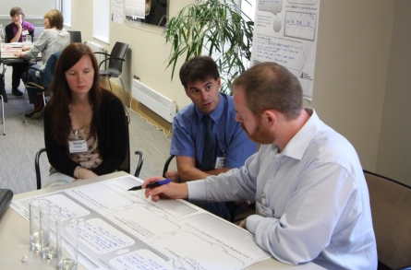
SUPER-B dissemination plan
Website
Research-stakeholder agenda-setting
Identify policy opportunities
Outreach training for scientists
Build partnerships between farmers, business, beekeepers, professionals
…and much more
Dissemination
Plan
Lyubomir Penev [Bulgaria]
Llynn Dicks
[UK]
Super-b@naturalis.nl

Slide 9
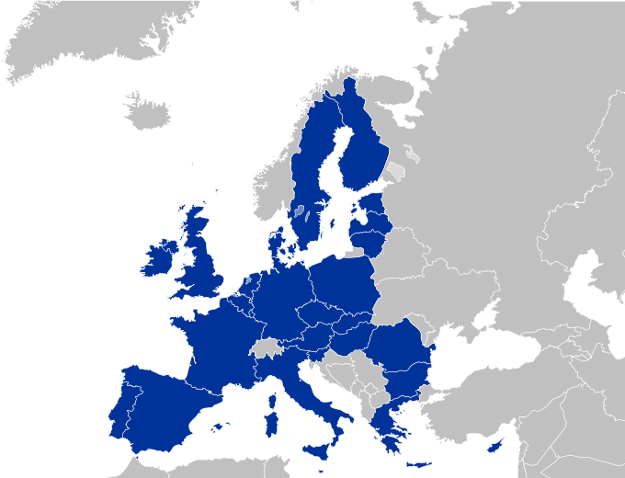







Who is Super-B ?
Novel crop pollination management guidelines
+
Argentina
New Zealand
South Africa
…..
Assess crop pollination deficits, stability and resilience
Standards for field and laboratory research methods
Improved use of managed bees
Quantify the relative contribution of factors driving declines
Improved wild pollinator conservation practice
Just starting
Free to join !!
Super-b@naturalis.nl
Super-b@naturalis.nl

Slide 10
How will SUPER-B deliver ?
Website as a focal information and dissemination point
Coordination of action:
MC meetings, clear work group structure, annual internal planning -reporting cycle
Open structure, stimulating spin-off activities and projects
Advance science interaction through:
- Annual conferences linked to planned scientific meetings
- STSMs and dedicated workshops/training events
Advance science-society-policy interaction through:
REACHING OUT: Stakeholder workshops, Policy makers workshop
Develop partnerships: science, farming, business, policy
Broad dedicated dissemination program
Super-b@naturalis.nl

Slide 11
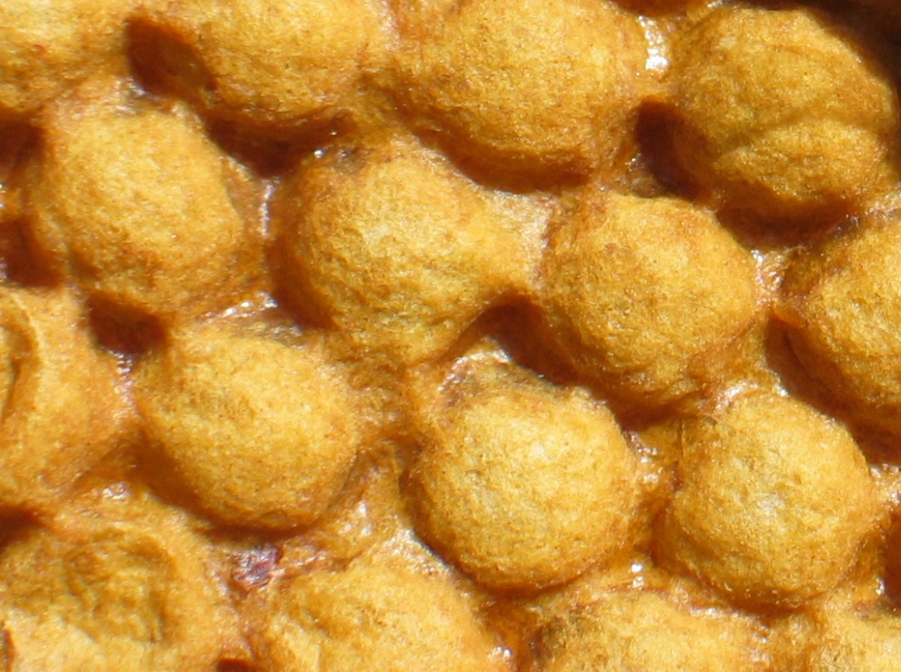
SUPER-B
Linking up knowledge for more effective science
Super-b@naturalis.nl

Slide 12
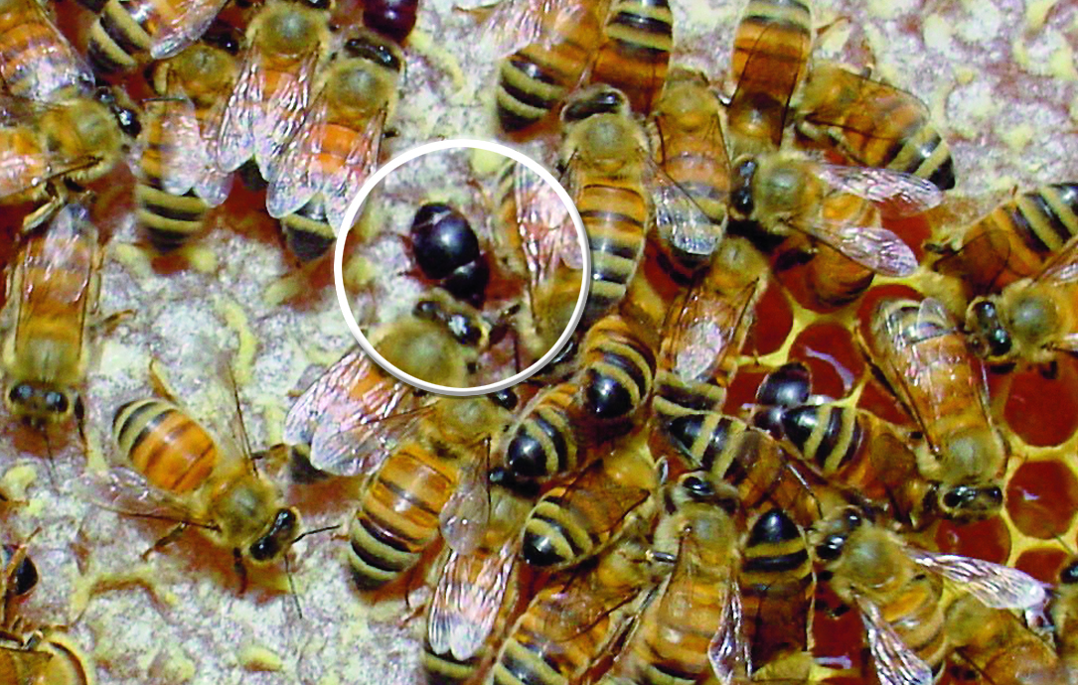
SUPER-B
a science network to address important pollination problems
Super-b@naturalis.nl

Slide 13
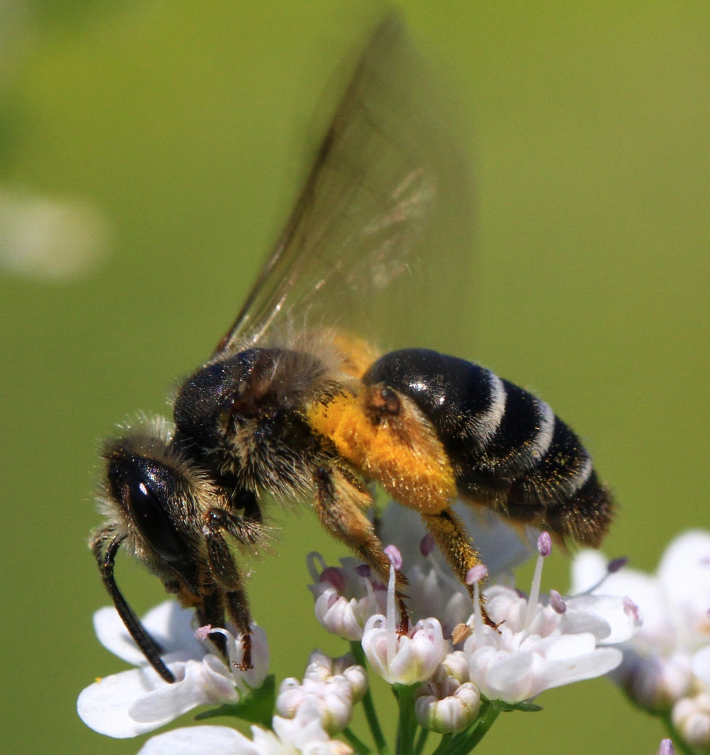
SUPER-B
Making a difference for food security and society
Super-b@naturalis.nl

Slide 14
THANK YOU
Improve production
Mitigation of loss
Drivers of loss
The main objective of the Action is to integrate knowledge and develop methods to underpin sustainable pollination services in Europe
Pollination research
Large network to share, tackle and develop
Super-b@naturalis.nl

